Slide 1

Customer Segmentation: Clustering
Wang Bi
a

Slide 2
Project Structure
Introduction
EDA
01
03
Project Background
Data Introduction & Process
Customer Feature & Behavior
Purchase Channel
Customer Activation
Cluster Model
Profile
02
04
Four Different Model
Model Selection
Customer Profile
Strategy Suggestion
a

Slide 3
Introduction
01
a

Slide 4
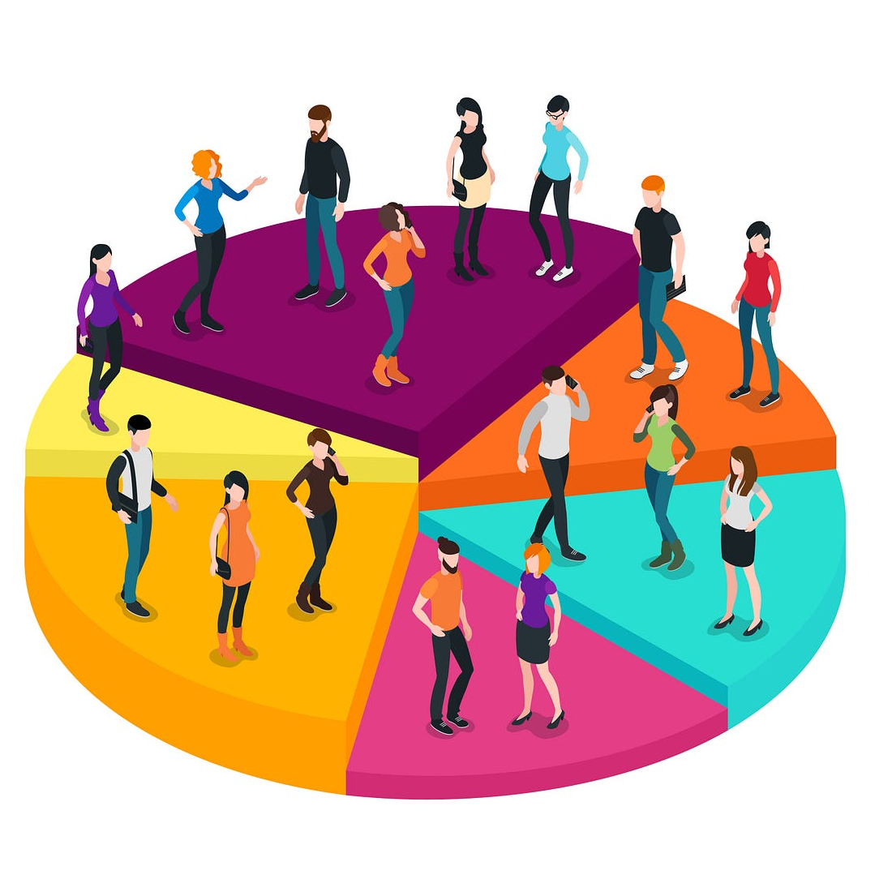
Background of Customer Clustering
Definition:
Customer clustering is the grouping of customers based on their similarities to better understand and meet the needs of different groups.
Significance:
Personalized Marketing and Service
Enhanced Customer Satisfaction and Loyalty
Increased Sales and Profits
Predictive Insights and Planning
a

Slide 5
About Data
Dataset
This dataset comes from Kaggle. It contains 1000+ data items and 27 variables. The main dimensions are people, products, promotions and channels.
a92737
Data Cleaning
Before starts, I delete NULL value, change the data types, drop outliers, do feature engineering and Scale the feature using the standard scaler.
a

Slide 6
IntrClusteringon
02
a

Slide 7
Clustering Model
Four Clustering Models
Model Selection
K-means
Agglomerative Clustering
Spectral Clustering
DBSCAN
Calculate the average silhouette score for every model
Select model with highest score
a

Slide 8
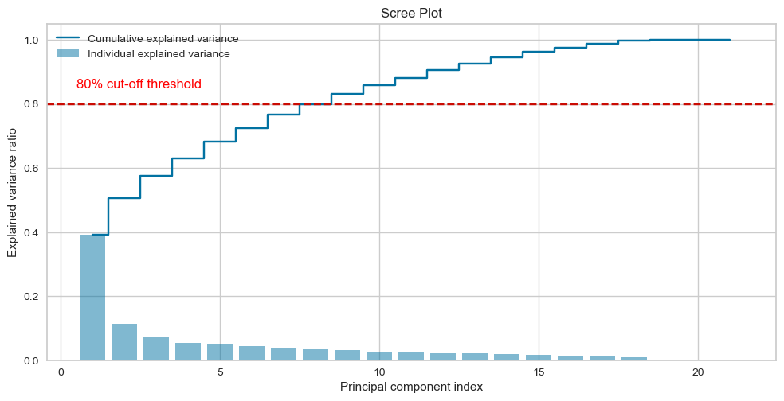
Clustering Model
PCA before Clustering
27 features is too much
I picked eight principal component while maintaining 80% explanatory power for the variance of the variables
a

Slide 9
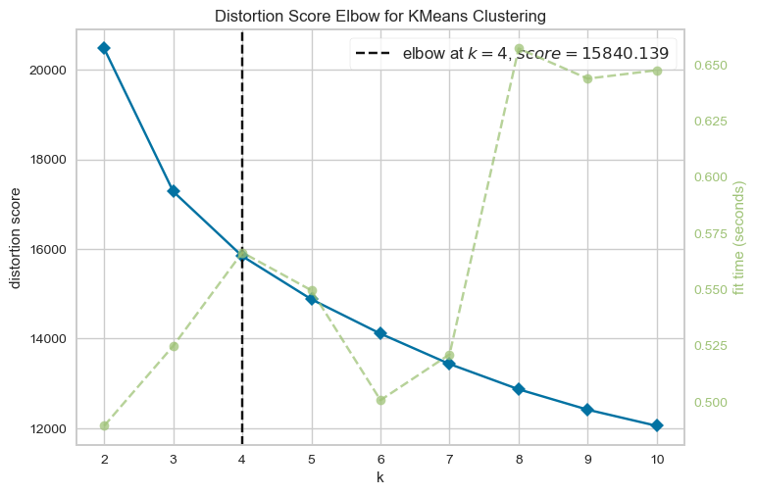
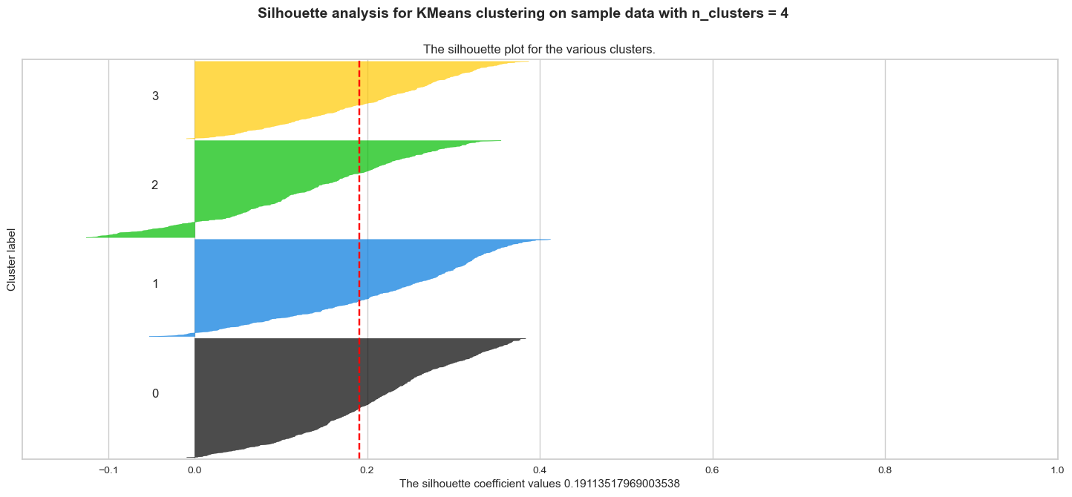
Model1: K-Means
Choose cluster number: Calculate distortion score and use Elbow rule to select clusters = 4
Calculate average silhouette score = 0.1911
a

Slide 10
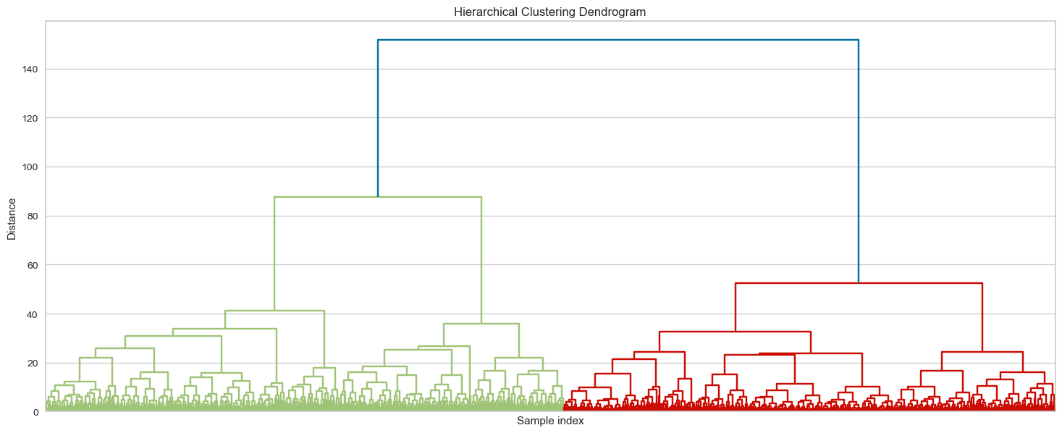
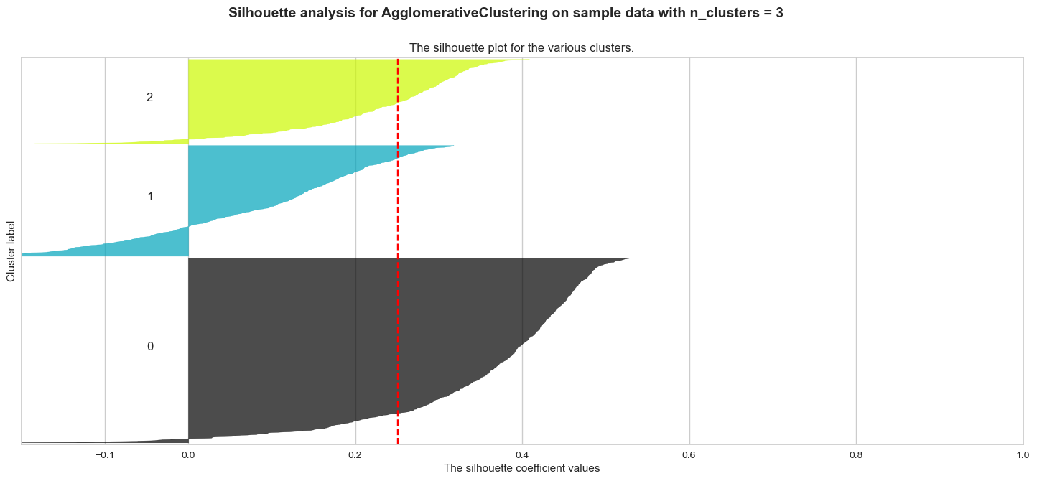
Model2: Agglomerative Clustering
3
1
2
Choose cluster number: use Dendrogram to find clusters with the longest merge distance, and finally set clusters = 3.
Calculate average silhouette score = 0.2507
a

Slide 11
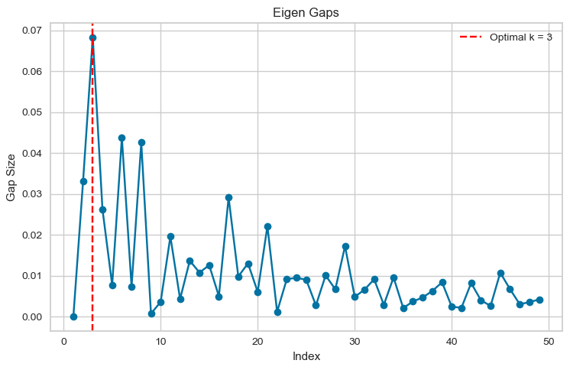
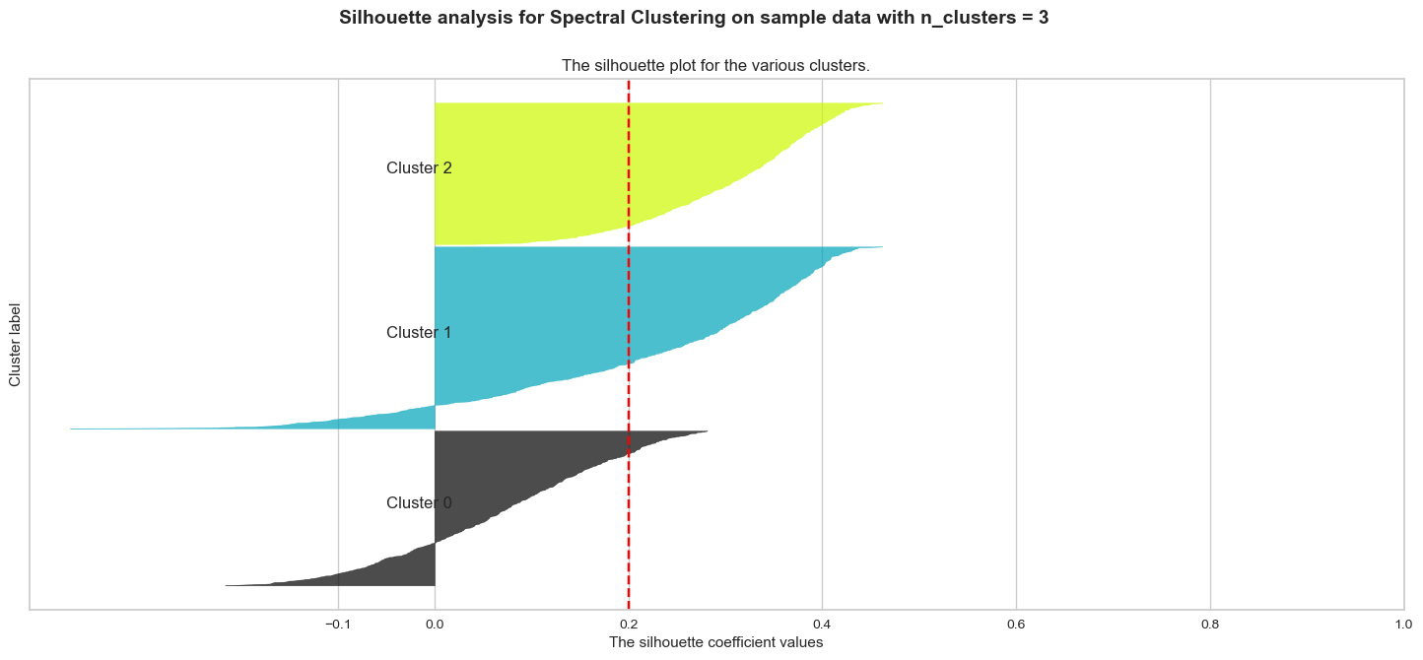
Model3:Spectral Clustering
Choose cluster number: calculate eigen gaps and select cluster number with highest gap size, and finally set clusters = 3
Calculate average silhouette score = 0.1999
a

Slide 12
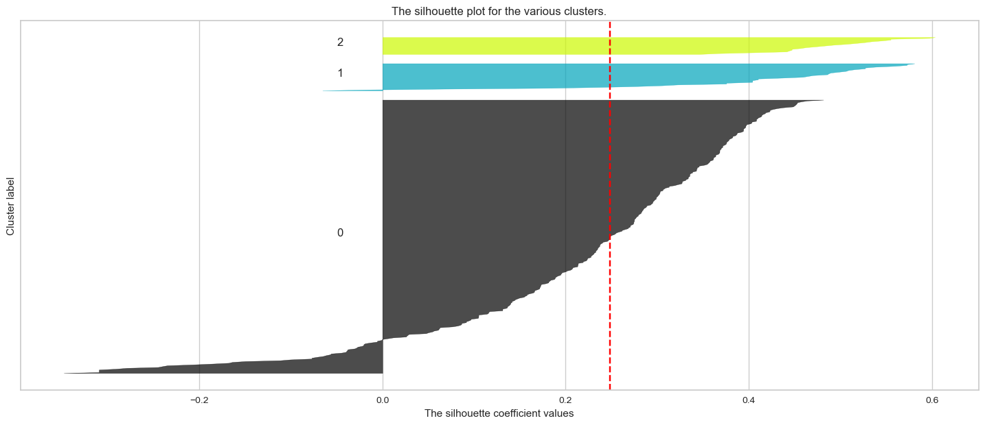
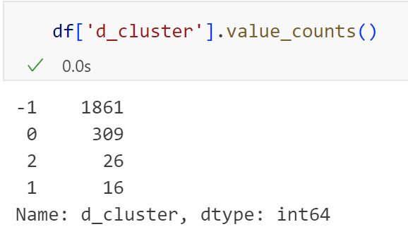
Model4:DBSCAN
“d_cluster” is the cluster label through DBSCAN
“-1” label means noisy point
No need to set cluster number in advance, calculate average silhouette score = 0.2487
Distribution of cluster is markedly uneven
Many data points are clustered as noisy point
Not a suitable model
a

Slide 13
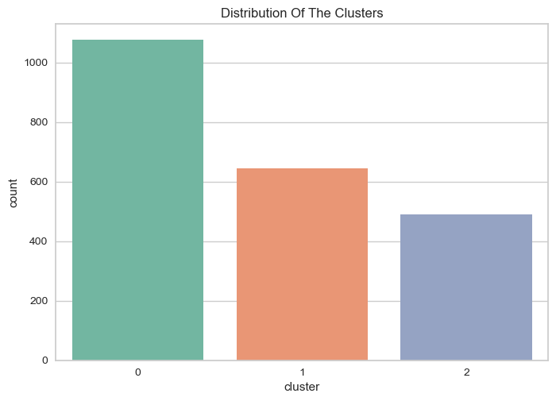
Model Selection
Model | Average Silhouette Score
K-Means | 0.19
Agglomerative Clustering | 0.25
Spectral Clustering | 0.20
DBSCAN | 0.24
Select Agglomerative Clustering finally
The clusters seem to be fairly distributed
a

Slide 14
Exploratory Data Analysis
03
a

Slide 15
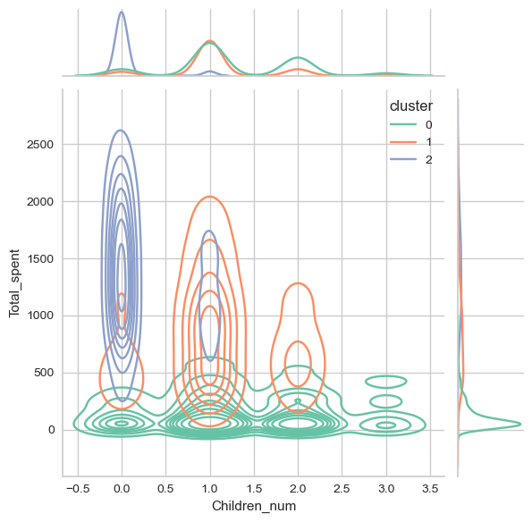
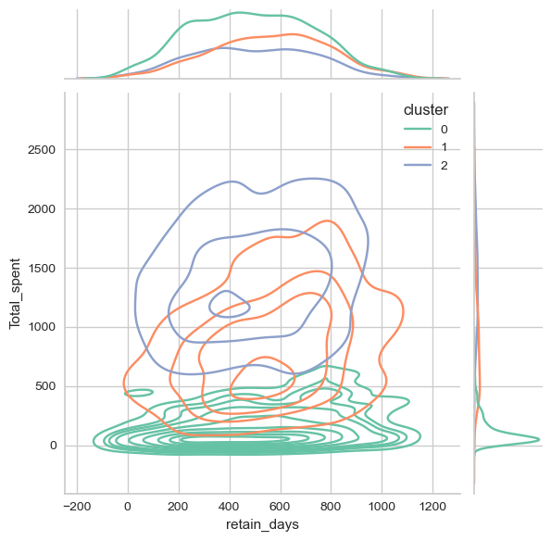
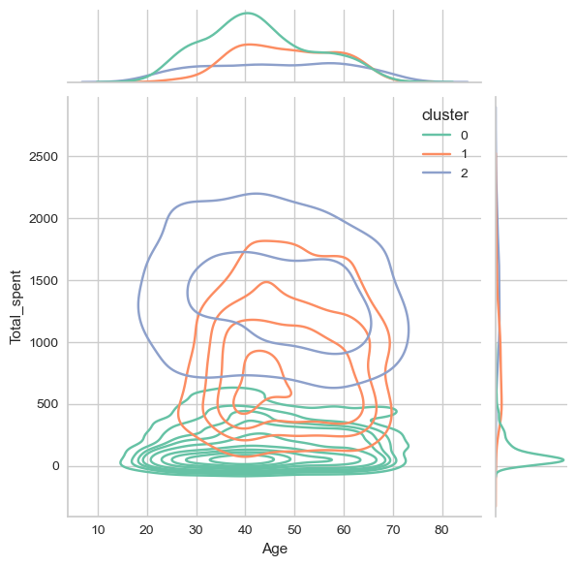
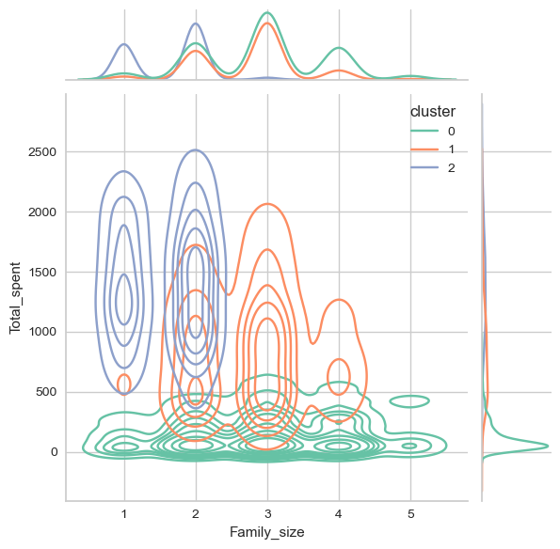
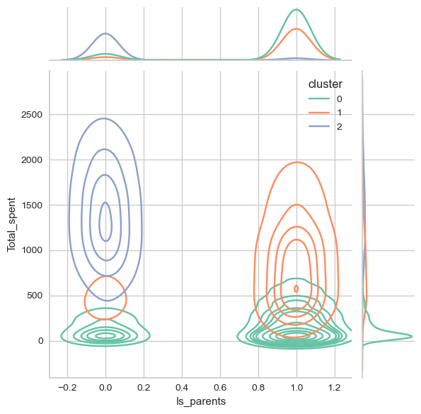
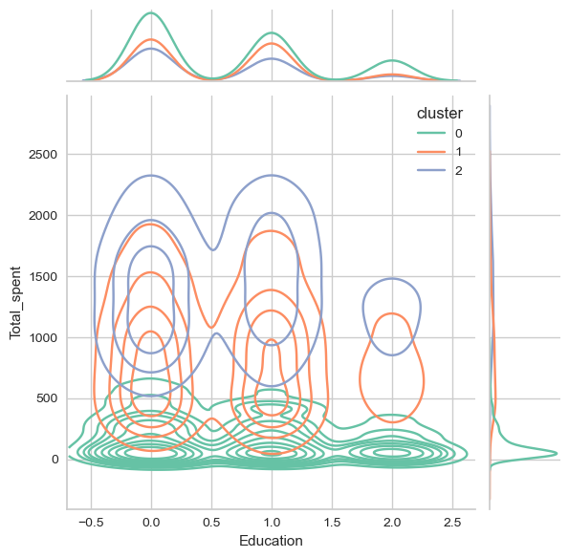
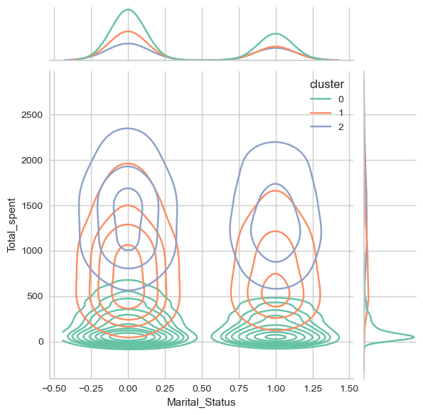
Customer Features
Kernel Density Estimate plot
Final analysis shown in profile part
a

Slide 16
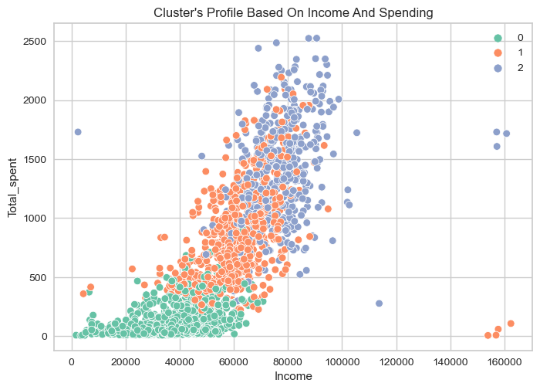
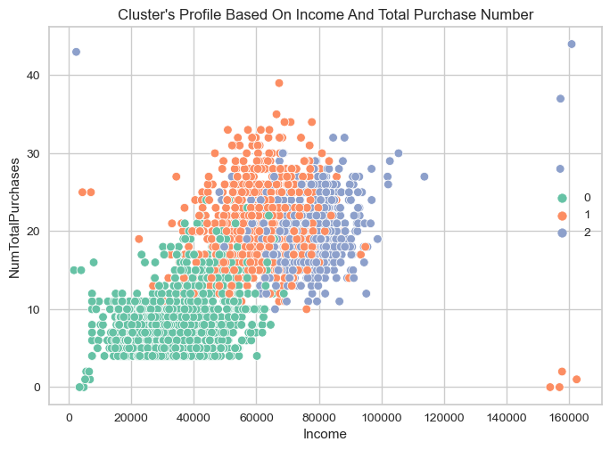
Customer Features
High-income customers do not necessarily make more frequent purchases,may because they prefer high-value goods
Total spent: Cluster2 > Cluster 1 > Cluster 0
a

Slide 17
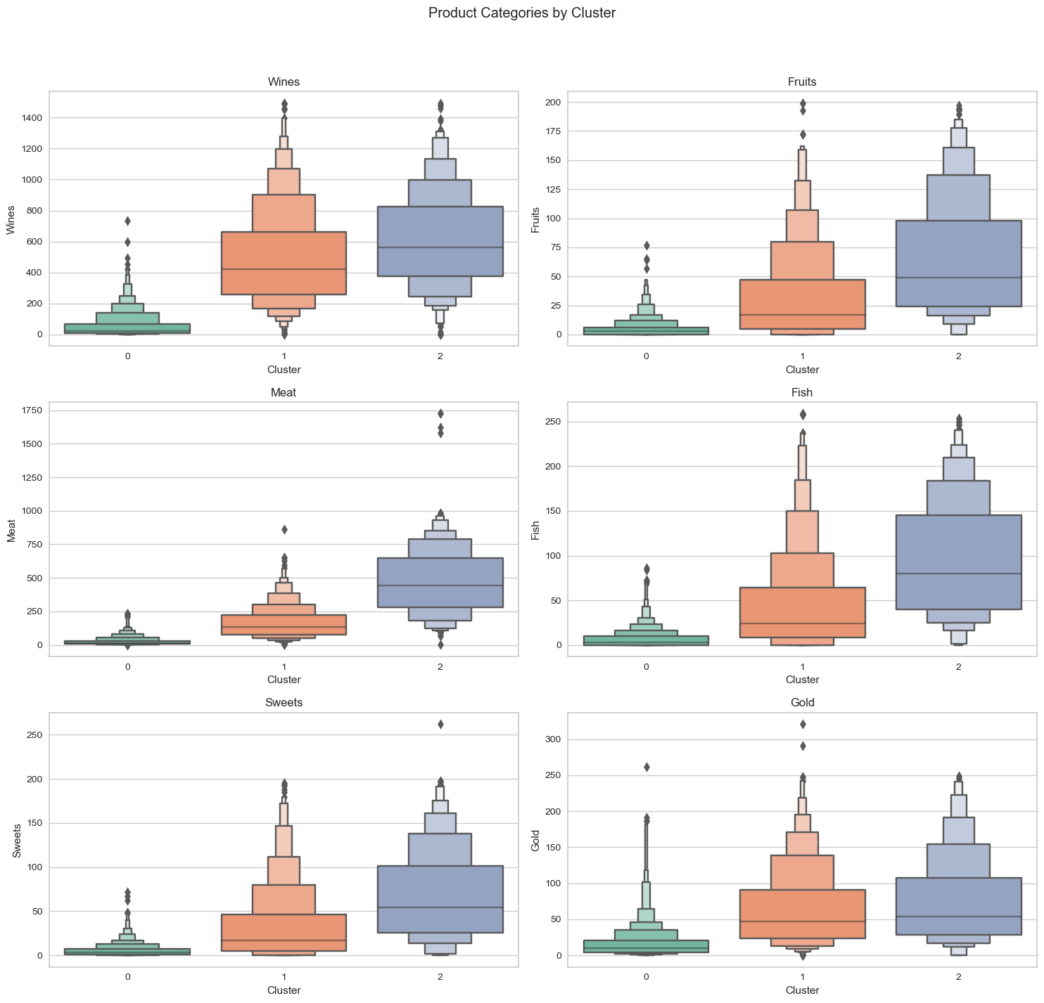
Product Preference
Boxplot
Total purchase number:
Cluster2 > Cluster 1> Cluster 0
Cluster 2 spends more than the other two groups on most product categories, especially on “Meat” and “Wine” products.
a

Slide 18
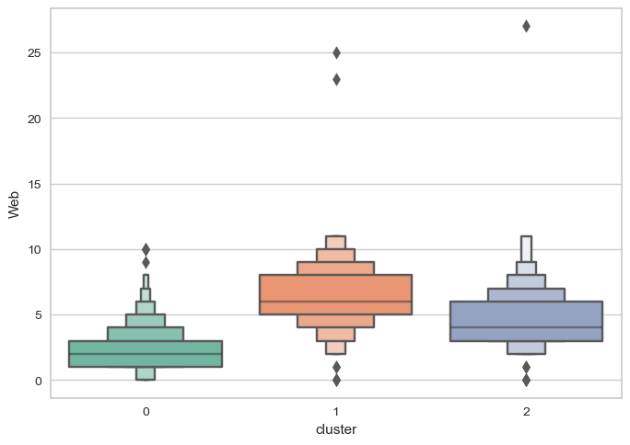
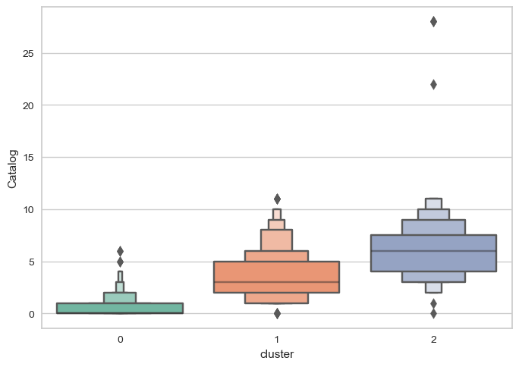
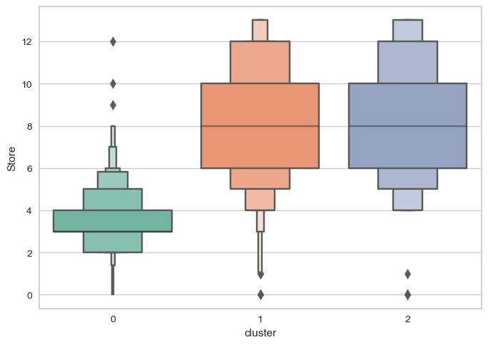
Purchase Channel
Cluster 1 and Cluster2 is active across all channel.
Web shopping: Cluster 1 > Cluster 2, Catalog shopping: Cluster 2 > Cluster1.
Cluster 0 makes relatively few purchases across all channels, which may indicate that they buy less frequently overall.
a

Slide 19
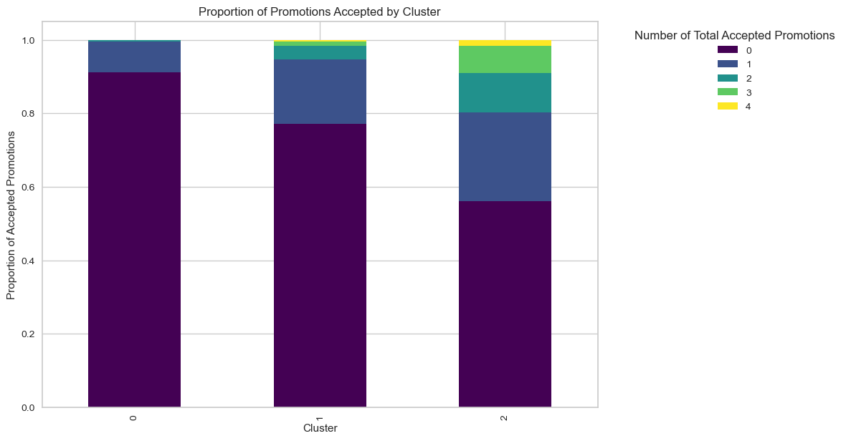
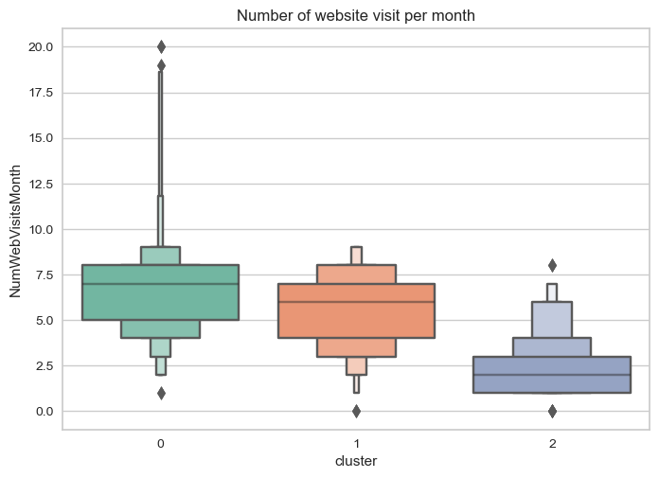
Customer Activation
The majority of customers tended not to take up any promotions, cluster2 participated in a relatively high number of promotions
Cluster2 has the lowest website activity, the other two clusters are similar
a

Slide 20
04
Customer Profileon
a

Slide 21
0
1
2
Budget-Conscious Family Shoppers
Prudent Established Spenders
Affluent Non-Parents
Lower income, Lower spent
Most around 40 years old
Most are parents with 1-3 children
Many Single parents
Relatively higher Education
Middle income, Middle spent
Most 40-60 years old
Definitely parents with 1 children
Most are graduation or lower
Lowest website visits
Higher income, Higher spent
Span all ages
Definitely not parents
Most are graduation or lower
Relatively the most participation in promotions
a

Slide 22
0
1
Prefer store shopping
Participate in few promotions
Wines and meat account for the largest amount of consumption
Common Characteristics
2
a

Slide 23
Marketing Strategy
For Budget-Conscious Family
Price Sensitive Offer Strategy
Price offers and discounts: These customers have lower incomes and lower spending levels, so we can offer ongoing price discounts, especially on everyday essentials and children's products. For example, a "Family Savings Package" can be set up, which includes a combination of discounts on a variety of common household items.
Education and Information Provision
Consumer Education: Provide educational resources and workshops on budget management and household savings to help these customers manage their household budgets more effectively.
Health and Nutrition Coaching: Provide free coaching and workshops on child nutrition and family health to increase consumer trust and reliance on the brand.
Building single-parent communities: Build customer communities through social media or offline community events to promote mutual help and support among single-parent families and enhance brand loyalty.
High-quality content marketing
Specialized content: The customer base is relatively well-educated, so it is possible to provide high-quality, information-rich advertising content, such as in-depth articles, industry analysis reports, and special lectures on financial management, healthy living, technological innovations and other areas they may be interested in.
Brand endorsement: industry experts or celebrities can be invited to write blogs or conduct interviews on a regular basis to provide insights and practical advice to improve brand endorsement.
a

Slide 24
Marketing Strategy
For Prudent Established Spenders
Value Optimization
Low and mid-range product: mainly launching mid-range products to ensure that the product price is not too high nor too cheap, focusing on value for money.
Traditional media advertising
Utilizing traditional media: Given the low online activity of this type of customer, advertisements can be placed through TV, radio and print media (e.g. newspapers, magazines), especially in local media, to increase brand visibility.
Direct mail marketing: distributing coupons or promotional information to be delivered directly through the mail, this method is still effective for some older age groups.
Simplified digital touchpoints
Simplify the website interface: for occasional users, ensure that the interface is intuitive and easy to use, minimising complex navigation and excessive clicking steps.
Enhance the mobile experience: Given that some users may access the site via mobile phones, optimising the access experience for mobile devices is also key, such as increasing page load speeds and improving the friendliness of the mobile interface to attract more pageviews.
a

Slide 25
Marketing Strategy
For Affluent Non-Parents
High-end and luxury product
Promote high-end products and services: Given their high spending power, promote high-end, luxury or customized services.
Limited edition products: Introduce limited edition or exclusive products to increase the scarcity and uniqueness of the product and attract consumers interested in uniqueness and novelty.
Co-operation with other brands: Co-operate with other high-end brands for cross-border co-branding activities to enhance brand endorsement.
Enhanced promotions and loyalty programs
Innovative promotions: As this group is more inclined to participate in promotions, innovative and attractive promotions can be designed, such as high discounts, doubling of rebate points, exclusive member days.
Premium membership system: Establish a premium membership system to provide members with privileges such as exclusive discounts, priority purchase rights and VIP customer service.
Focus on personal interests and lifestyle
Promote high-end personal consumer products: Concentrate on high-end personal consumer products and services such as premium personal care products, beauty and spa services, etc.
Health and well-being: Given that this group is likely to be more focused on personal health, health-related products and services can be promoted, such as organic food and health supplement.
a

Slide 26
Thanks!
Does anyone have any questions?
E1162679@u.nus.edu
a

